Slide 1
An Introduction to Human Rights and Responsibilities
Chapter 5:
Rights and Responsibilities

Slide 2
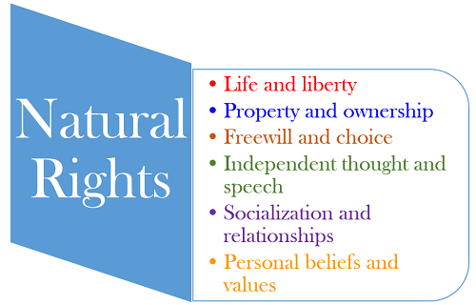
Natural right

Slide 3
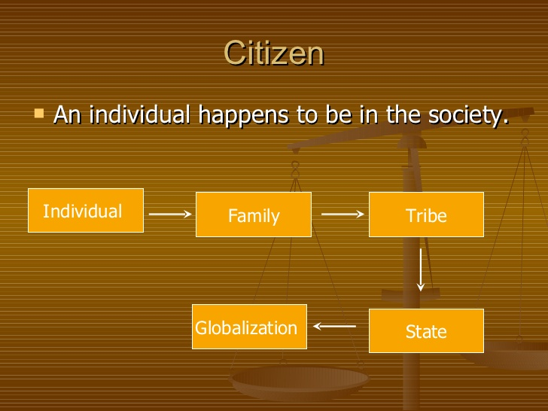
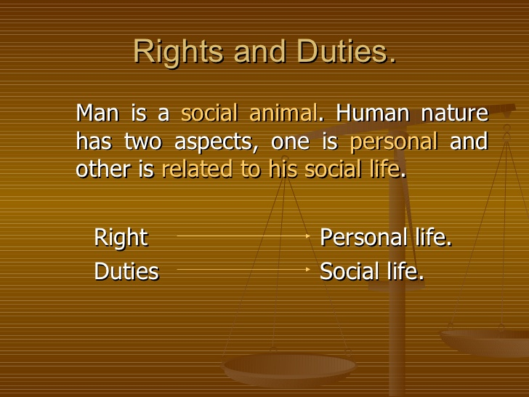
Right& duties

Slide 4
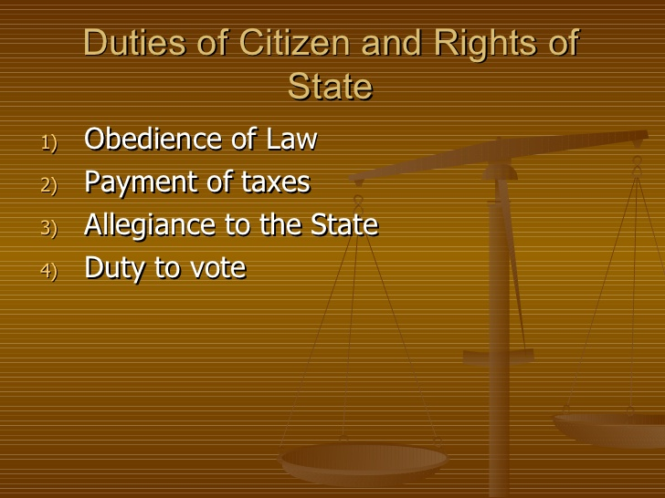
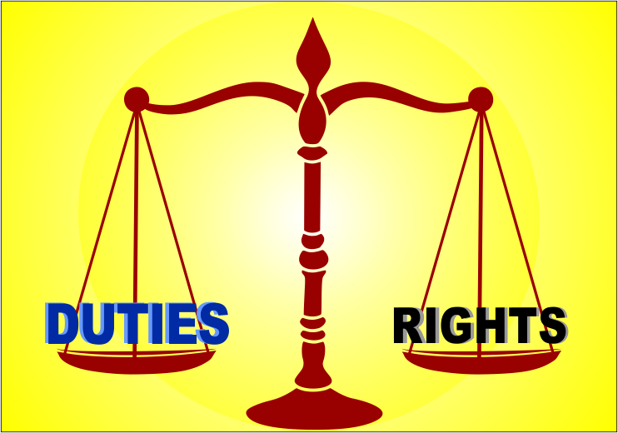
Duties

Slide 5
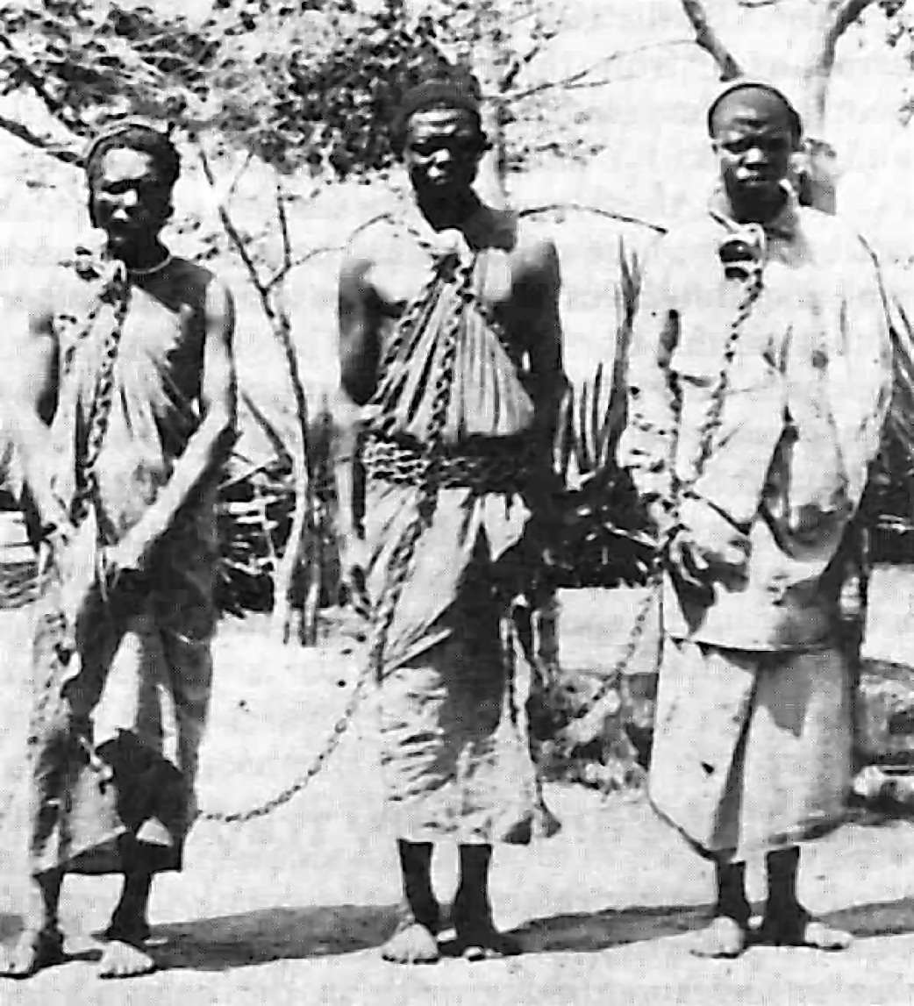

Slide 6
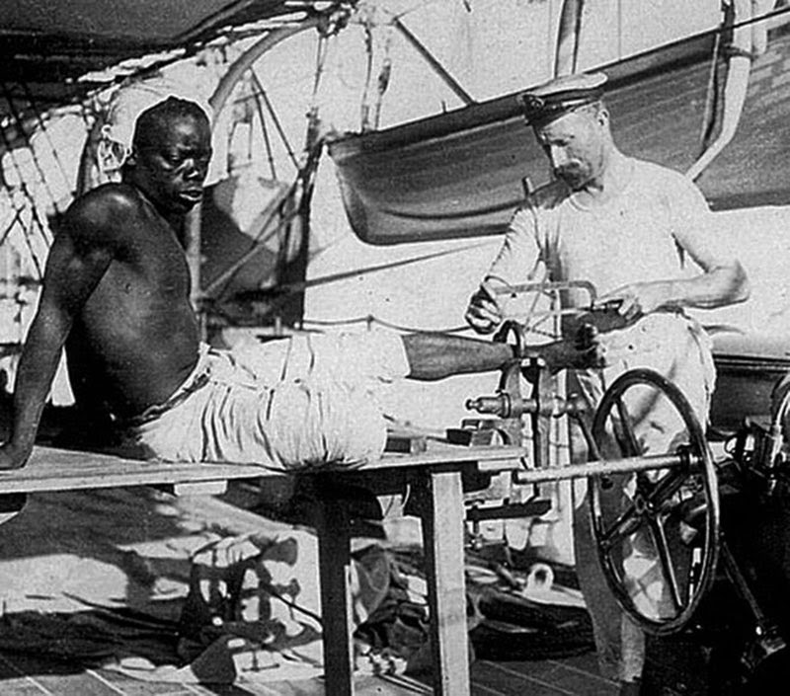
A British blacksmith removing the leg irons off a slave, 1907.

Slide 7
What do you think about the pictures?
How do you feel about them?
What is your opinion about slavery?

Slide 8
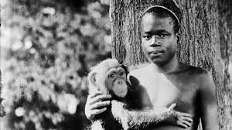
Ota Benga, was put on permanent display in the Bronx Zoo. He was placed in the monkey house, where he was labelled as "The Missing Link," implying that he occupied a lower rank in the evolutionary ladder than did white people.

Slide 9
Do you believe that any human being deserves such a treatment?
Provide reason to support your answer.
If yes, WHY? If no, WHY NOT?
https://www.youtube.com/watch?v=hyVJHpiHO8I

Slide 10
What are rights?????

Slide 11
Right:
A ‘right’ is a claim to have or do something that is justified on moral or legal grounds.
OR
A ‘right’ is a moral or legal entitlement to have or do something

Slide 12
Moral & Legal Rights
Moral Rights | Legal Right
Justified only on moral ground Are not supported by the law | Justified on legal grounds (as well as moral grounds) Are supported by the law

Slide 13
Activity:
List the things you would have in your ideal classroom
You may identify objects (such as tablets, comfortable chairs & books) as well as concept (such as respect, safety, FREE TIME & a clean environment)
Go through your list and decide whether each item is:
a ‘want’ ( nice to have but not essential)
a ‘need’ (essential to have in good class room)
a ‘right’ (so important to have in the classroom that you have a right to expect it)

Slide 14
WANTS, NEEDS & RIGHTS
Some things are more important than others to help us thrive and reach our full potential. Let's think about what things we might want and need, and what we have a right to expect in our life

Slide 15
WANTS, NEEDS & RIGHTS
 | Want | Need | Rights
Shelter
Personal room
IPhone
Fair treatment
Car
Clean air
Freedom to Practice religion

Slide 16
Positive Rights and Negatives Rights
Rights to have Something (positive rights)
The right to health
The right to have privacy
Rights to be free from something (negative rights)
The right to be free from slavery
The right to be free from discrimination

Slide 17
Underlying Values of Human Rights
What do you think the underlying values of human rights are?
Examples:
What value/values we emphasize on when we demand that like a boy, a girl child should also have education?
What value(s) is stressed when we demand that one should be allowed to practice ones culture and religion?

Slide 18
Underlying Values of Human Rights
Some key underlying values of human rights are:
Equality
Respect
Freedom
Dignity
Justice
Golden rule: ‘treat others as you wish to be treated’

Slide 19
Brief History of Human Rights
The idea that individuals have basic rights in its current form is relatively new
The Constitution of Medina (622/624) ; first recorded declarations of human rights
The Magna Carta (1215)
Universal Declaration of Human Rights (1948)

Slide 20
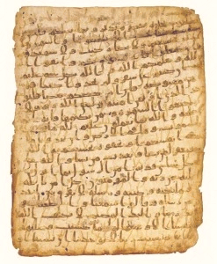
Medina Charter
Agreement between Islamic Prophet Muhammad (P.B.U.H) and people of Medina
Based on the idea that freedom, justice & equality are important

Slide 21
Magna Carta Libertatum; "the Great Charter of the Liberties"
https://www.youtube.com/watch?v=7xo4tUMdAMw

Slide 22
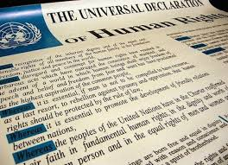
The Universal Declaration of HUMAN RIGHTS
The most widely used human rights declaration today
Formed by United Nations just after world war II 1948
Unfortunately it is a declaration not a law

Slide 23
Main Provisions of UDHR
https://www.youtube.com/watch?v=hTlrSYbCbHE

Slide 24

WHAT HUMAN RIGHTS DO WE HAVE?
Which human right is represented in this picture?

Slide 25
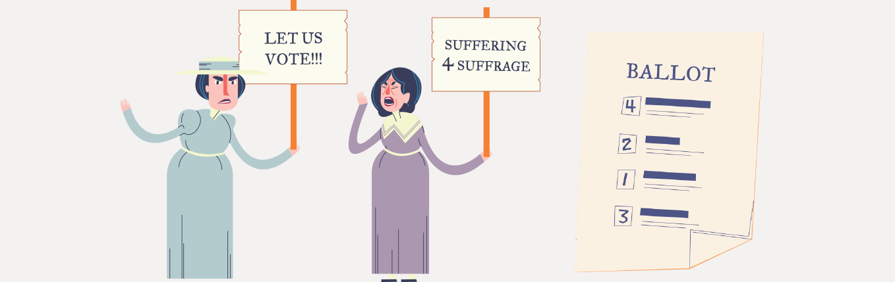
WHAT HUMAN RIGHTS DO WE HAVE?
Which human right is represented in this picture?

Slide 26
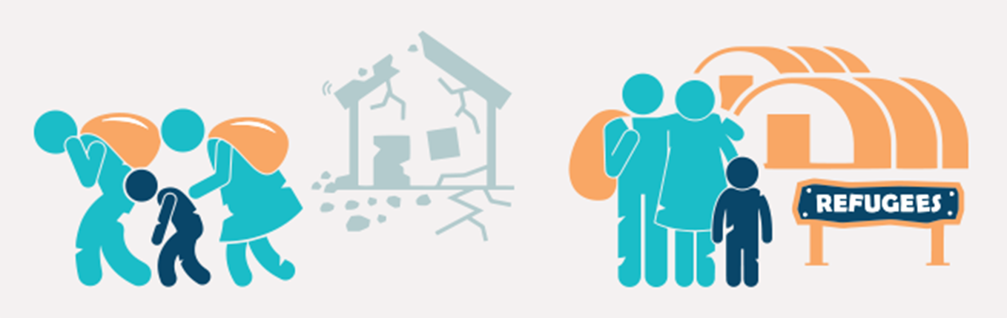
WHAT HUMAN RIGHTS DO WE HAVE?
Which human right is represented in this picture?

Slide 27
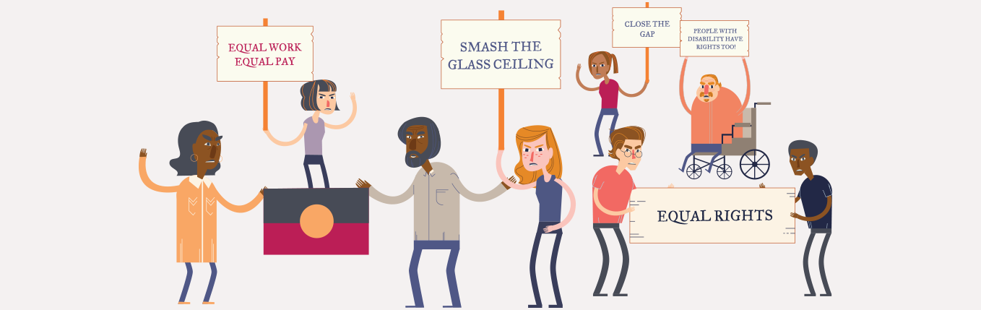
WHAT HUMAN RIGHTS DO WE HAVE?
Which human right is represented in this picture?

Slide 28
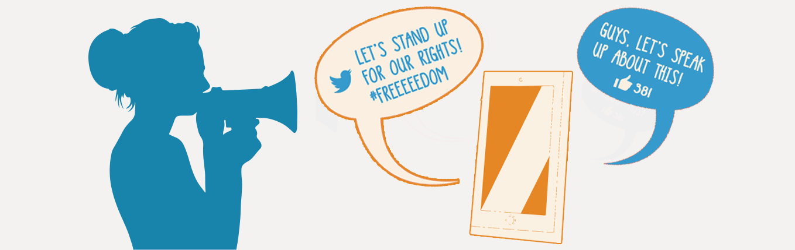
WHAT HUMAN RIGHTS DO WE HAVE?
Which human right is represented in this picture?

Slide 29
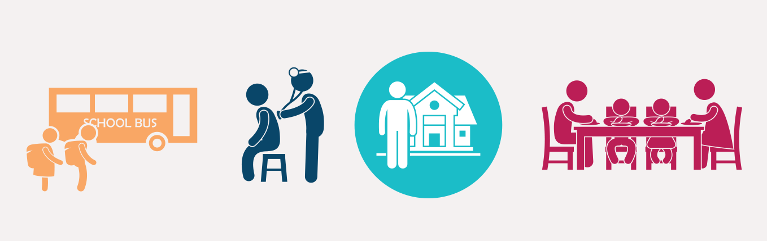
WHAT HUMAN RIGHTS DO WE HAVE?
Which human right is represented in this picture?

Slide 30
Rights and Responsibilities
go hand in hand

Slide 31
Rights presume Responsibility
Your right becomes someone else’s responsibility and someone else’s right your responsibility
Your right becomes your responsibility too
Principle of ‘reciprocity’

Slide 32
Read the following rights and use your own words to rephrase them as personal responsibilities:
Question1.
I have a right to feel safe

Slide 33
Answer:
I have a responsibility to behave in a way that will keep myself and others safe

Slide 34
Question 2:
I have a right to speak freely and express my ideas and opinions

Slide 35
Answer:
I have a responsibility to be respectful of other people's ideas and opinions even if they are different to mine

Slide 36
Question 3:
I have the right to be treated the same as everyone else, no matter my age, sex, race, nationality, beliefs or other personal characteristics

Slide 37
Answer:
I have a responsibility to treat others equally, without discrimination

Slide 38
Question 4:
I have the right to believe in a particular religion or belief, or in no religion at all

Slide 39
Answer:
I have the responsibility to respect the different religions and beliefs of other people and the ways they choose to practice their beliefs

Slide 40
Your rights and responsibilities in this University
List five rights and five responsibilities which you have as a student of this University

Slide 41
Your rights and responsibilities in your Country
List five rights and five responsibilities which you have as a Pakistani Citizen

Slide 42
Your rights and responsibilities in this world
List five rights and five responsibilities which you have as a citizen of this world (Global Citizenship)

Slide 43
You can make a difference by in this world by:
Standing up for your rights
Respecting rights of other human beings
Fulfilling your responsibility
Lets make a difference

